Slide 1

Users and Usability Principles
Lec 2

Slide 2
What is Usability?
Quality attribute
Learnability: How easy is it for users to start using the system?
Efficiency: How quickly can they perform tasks?
Memorability: How easily can returning users reestablish proficiency?
Errors: How many errors do users make, how severe are these errors, and how easily can they recover from the errors? How much does the system help prevent errors?
Satisfaction: How pleasant is it to use the system?

Slide 3
Why Usability is Important
If a website is difficult to use, people leave.
If the users can’t tell what the site offers, they leave.
If users get lost on a website, they leave.
If a website’s information is hard to read or doesn’t answer users’ questions, they leave.
Users won’t read a website, they scan the site. When users encounter a difficulty, they leave.

Slide 4
Usability Principles of the Day
Understand the users
Design for the user
Match the users’ mental model
Have a point, make your point
Prevent errors
Reduce excise tasks
Golden rules of UI design
Shneiderman’s five criteria:
Learn, Speed, Errors, Skills, SS

Slide 5
Understand the Users
It is important to know who the user is
Work experience
Computer experience
Age
Education
Reading skills
Language skills
Work environment
Task frequency
… many more possibilities
Do users look at web apps the way they are?
Or do users look at web apps the way they think?
“User profile”

Slide 6

Designing for the User
Engineers tend to focus on functionality
But if users cannot always understand how to use all the exciting features … They won’t
My watch has five buttons
I normally use one (button #5)
Button
#1
Button
#2
36-fine-printed-pages manual !!
Can I set time without looking at the manual?
How about a stopwatch feature?
Button
#3
Button
#4
Button
#5

Slide 7
Design of UIs
Inside-out design
Develop a system
Then add the interface
Outside-in design
Design the interface
Then build the system to support it
Traditional computer science courses are almost entirely inside-out!
When design decisions are made,
either the developer must conform to the users,
or the user must conform to the developer.
Web sites sink or swim based on the usability

Slide 8
UIs and Mental Models
Telephones: I want to call mom, not 1-434-xxx-xxxx
Compile: I want to run my program, not compile, run

Slide 9
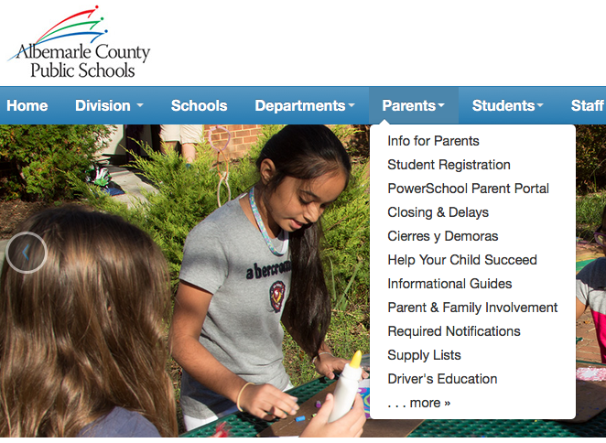
Fundamental Software Design Principle The 7 ± 2 Rule
Human’s short term memory can only hold about seven things at a time (plus or minus 2)
When we get more than about 7 items, we get confused
Notes:
https://www2.k12albemarle.org/Pages/default.aspx

Slide 10
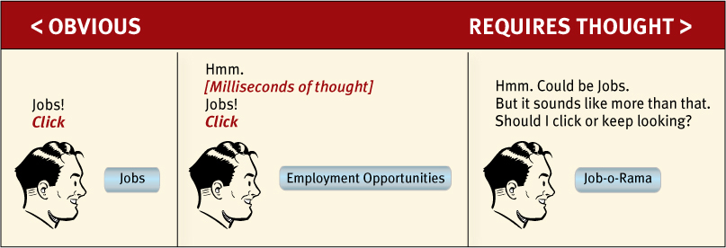
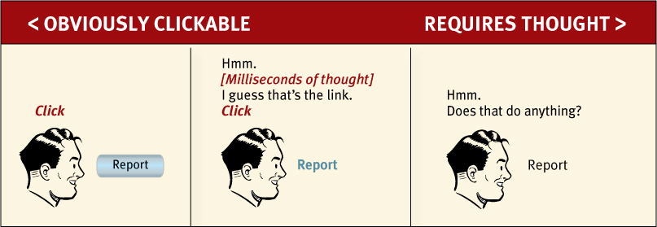
Have a Point, Make Your Point!
You have less than two minutes to convince first time visitors to stay on your web site
Every page must justify WHY the user should stay
[Figures from Steve Krug, “Don’t Make Me Think.”]

Slide 11
“Stuff” happens
If an error is possible, someone will make it
Good UI designers must assume all possible mistakes will happen
Design to minimize the chances of mistakes
Design to minimize the consequences of mistakes
Design to maximize recovery from mistakes
Do not assume users are perfect
Notes:
People do make errors. Complex devices will always require some instruction, and someone using them without instruction should expect to make errors and to be confused. However, designers should take special pains to make errors as cost-free as possible.
If an error is possible, someone will make it. The designer must assume that all possible errors will occur and design so as to minimize the chance of the error in the first place, or its effects once it gets made. Errors should be easy to detect, they should have minimal consequences, and, if possible, their effects should be reversible.

Slide 12
Reduce Excise Tasks
Don’t make me think
also means
Don’t make me do work that’s not
related to my goal

Slide 13
Techniques to Avoid Excise
Put the mouse focus in the first input box
Don’t interrupt flow unless necessary
Try not to show error messages
Don’t ask users to “correct” what they don’t understand
Don’t separate input from output
Don’t require passwords for everything
Authentication is almost always excise!

Slide 14
Techniques to Avoid Excise (cont.)
Don’t make users move or resize windows
Don’t make users remember or reenter personal settings
Don’t make users enter unnecessary data
Don’t make users confirm actions – unless undo is impossible

Slide 15
Golden Rules of UI design
Build a UI that is consistent
Design usable and discoverable shortcuts
Provide appropriate feedback
Provide appropriate error handling
Allow users to undo all actions
Use hesitation for the operation that cannot be “undone”
Design for the user

Slide 16
Shneiderman’s 5 Criteria for Measuring Usability
Time to learn: The time it takes to learn some basic level of skills
Speed of UI performance: Number of UI “interactions” it takes to accomplish tasks
Avoiding user errors: How often users make mistakes
Retention of skills: How well users remember how to use the UI after not using for a time
Subjective satisfaction: The lack of annoying features

Slide 17
Speed of UI Performance
This is about navigating through the interface, not how fast the software or network runs
Interaction points are places where the users interact with the software (e.g., buttons, text boxes, or commands)
Speed of UI performance is roughly the number of interactions needed to accomplish a task
Good UI designers need to reduce the number of keyboard-to-mouse switches
Speed of user interface – NOT software, hardware, or network

Slide 18
How to Improve Usability
Usability testing
Get representative users
Ask the users to perform representative tasks
Observe how the users use or interact with the UI
What the users do
Where they succeed
Where they have difficulties with the UI

Slide 19
Tips When Working on Usability
Test the old design before staring a new design
Test your competitors’ designs
Study how users use the system
Make paper prototypes and test them
Transform paper prototypes to executable prototypes, iteratively refine the design idea
Inspect the design relative to established usability guidelines
Implement the final design, test it again.
Don’t wait until you have a fully implemented design. It will be impossible to fix the critical usability problems, especially problems related to architectures.
Start user testing early in the design process and keep testing every step

Slide 20
Summary
Good UIs take time to design
Designing a good UI requires thinking like the user instead of an engineer
Engineers often think they are users
Different users want different things
Engineers love features
They want to do everything the technology allows!
All an interface designer has to do is
Be polite
Be considerate
Be clear

